Slide 1
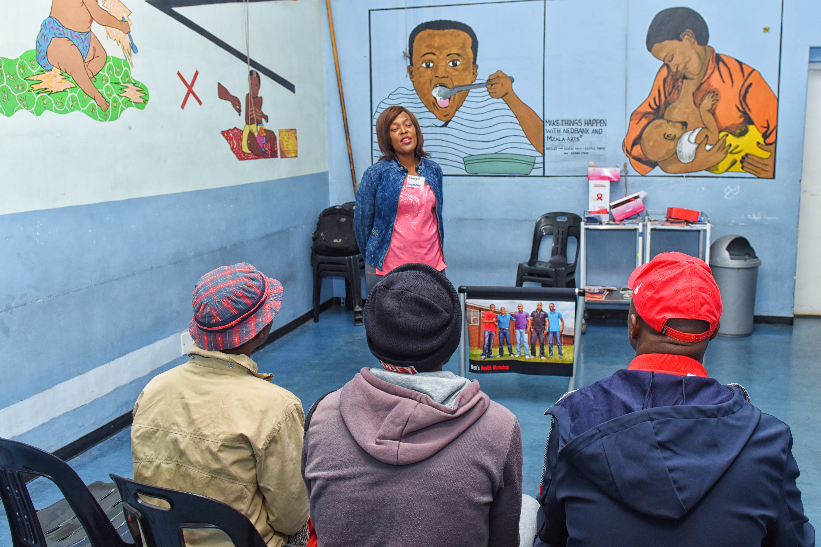
IAS 2019
Unitaid, WHO, PSI
Reaching Men

